Slide 1

Efficient Influence Maximization
in Social Networks
Presented by WAN, Pengfei
Dept. ECE, HKUST
Wei Chen, et al, “Efficient Influence Maximization in Social Networks”, KDD09’

Slide 2

OUTLINE
• Problem
• Previous Work
• Degree Discount Heuristics
• Summary
• References

Slide 3
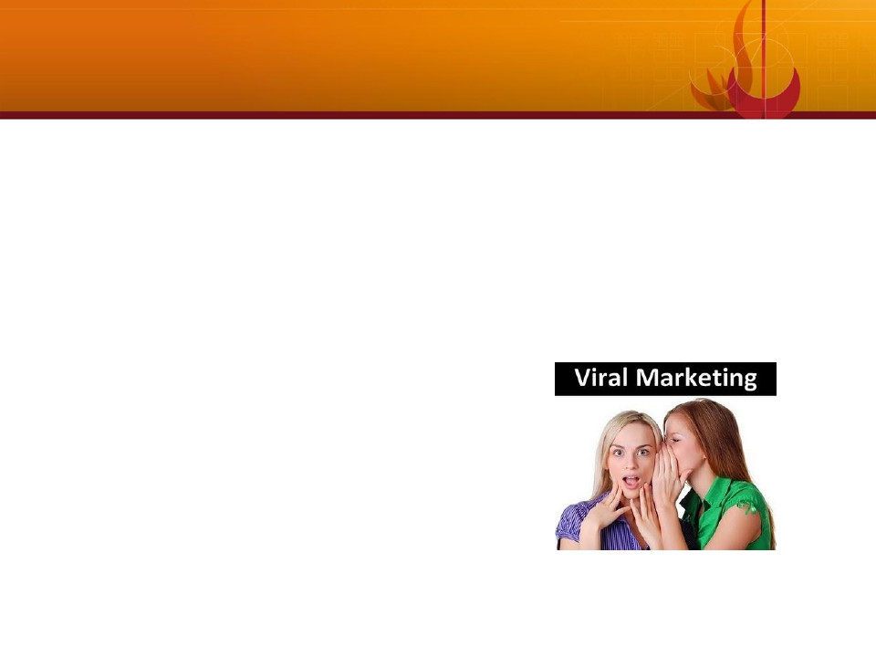

Problem Statement
•
•
•
Find a small subset of nodes in a social network that could maximize the
spread of influences.
Known as Influence Maximization
A.k.a Viral Marketing which makes use of “word-of-mouth marketing”
properties of social network

Slide 4
Problem Statement
•
•
Optimization problem first introduced by Domingos and Rechardson,
KDD01’/02’, NP-hard to solve
Elegant graph formulation introduced by Kempe, et al, KDD03’
Given:
✓ A graph G(V, E):
--Vertices: individuals in social network
--Edges:
connection or relationship
✓
k, size of output seeds
✓ A cascade model: LTM, ICM
Output:
S, a set of seeds (nodes) that maximize the expected number of nodes active in the end

Slide 5
Problem Statement: Cascade Model
•
•
•
•
•
Models how influences propagate
Linear Threshold Model (LTM)
Independent Cascade Model (ICM)
… …
Analogous to Epidemic Models like SIS, SIR

Slide 6
Linear Threshold Model
•
•
A node u has random threshold θu ~ U[0,1]
A node u is influenced by each neighbor v according to a weight buv witch
satisfies:
∑
v neighbor of u
bu,v =1
•
A node u becomes active when at least θu fraction of its neighbors are
active
∑
v active neighbor of u
bu,v ≥θu

Slide 7
Independent Cascade Model
•
•
•
When node u becomes active, it has a single chance of activating each
currently inactive neighbor v.
The activation attempt succeeds with probability puv.
In both LTM and ICM, active nodes never deactivate.

Slide 8
OUTLINE
• Problem
• Previous Work
• Degree Discount Heuristics
• Summary
• References

Slide 9
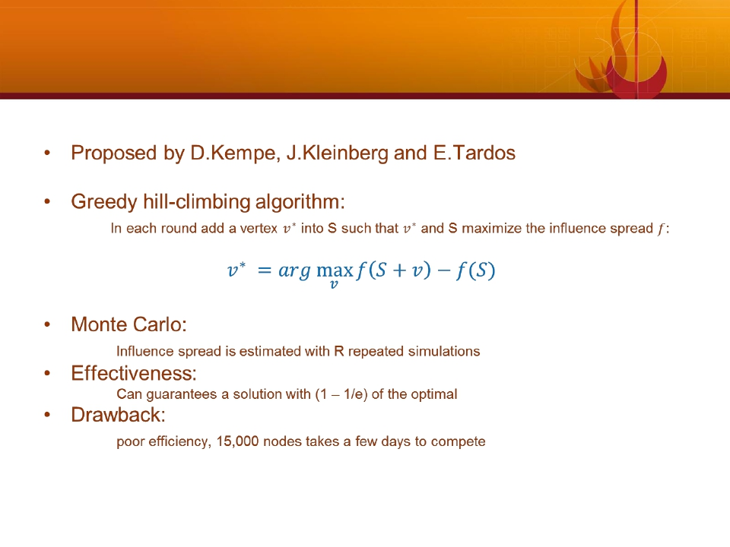
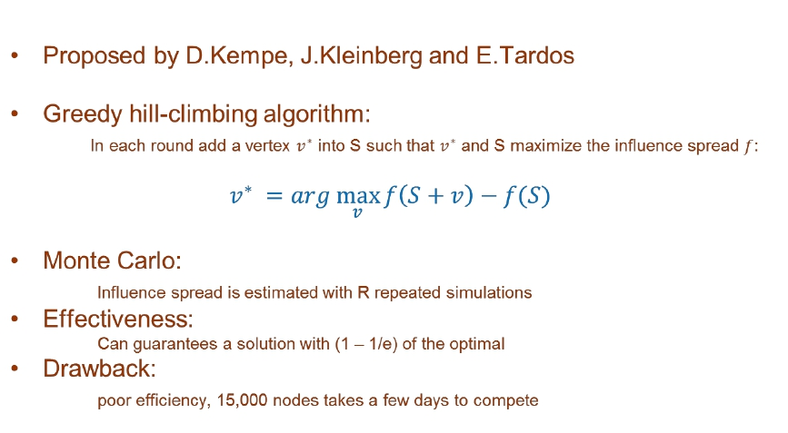
Previous Work:
“Maximizing the Spread of Influence Through a
Social Network”,KDD03’

Slide 10
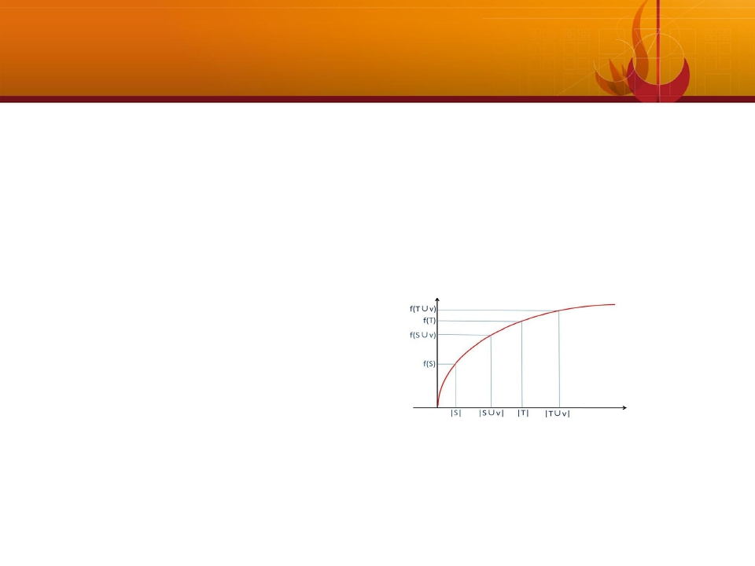
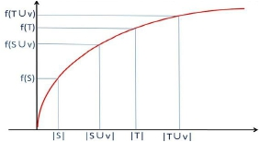
Previous Work:
“Cost-effective Outbreak Detection in Networks”,
KDD07’
• Proposed by J. Leskovec, A. Krause, et al
• Cost-effective Lazy Forward algorithm:
The CELF optimization utilizes submodularity of influence spread function to greatly reduce
the number of evaluations of vertices, and get the same performance as the original greedy algorithm.
• Submodularity:
∀S ⊂T ⊂ N,∀v∈N \T,
f (S +v)− f (S)≥ f (T +v)− f (T)
• Efficiency:
approximately 700 times fast than original greedy algorithm, but still hours to finish.

Slide 11
OUTLINE
• Problem
• Previous Work
• Degree Discount Heuristics
• Summary
• References

Slide 12
Degree Discount Heuristics
• Proposed by W.Chen, Y.Wang , S.Yang from MSRA and Tsinghua
• High Efficiency:
Amazingly reduces the running time by over six orders of magnitude with less than 3.5%
degradation in performance.
• Motivation:
Conventional degree/centrality based heuristics perform poorly in practical scenarios because
they ignore the network effect.
Important Fact: Since many of the most central nodes may be clustered, targeting all of them is
not at all necessary.

Slide 13
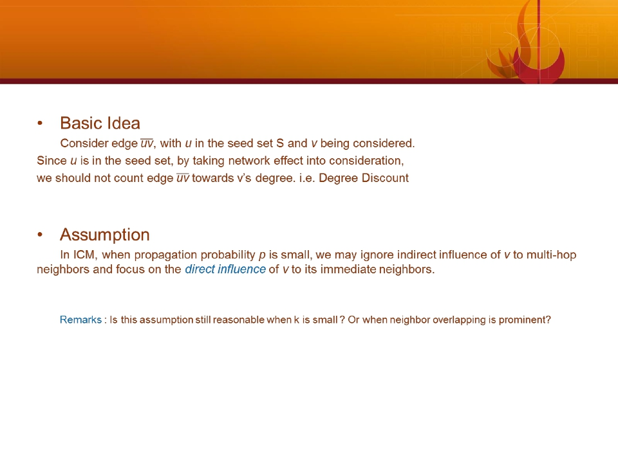
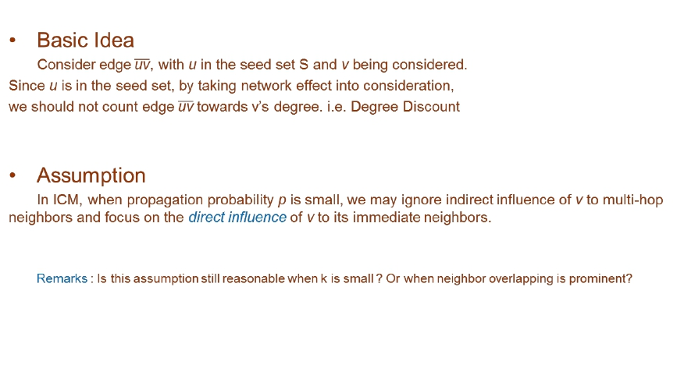
Degree Discount Heuristics

Slide 14
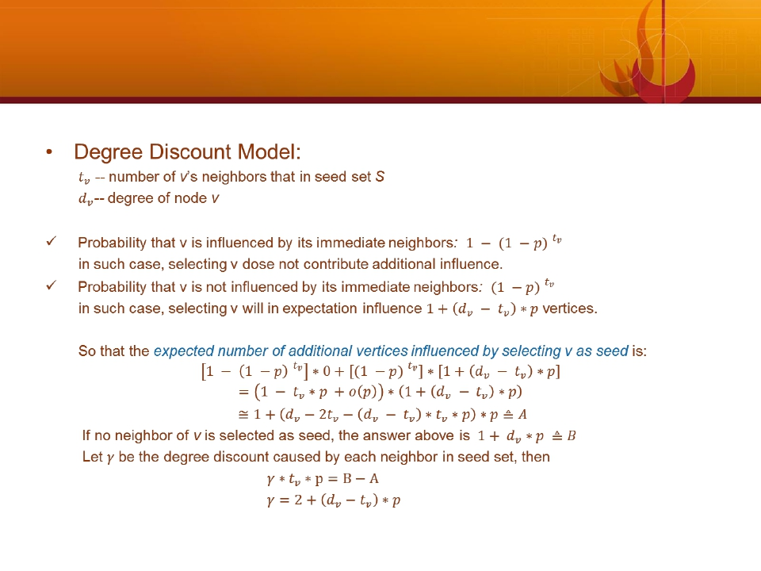
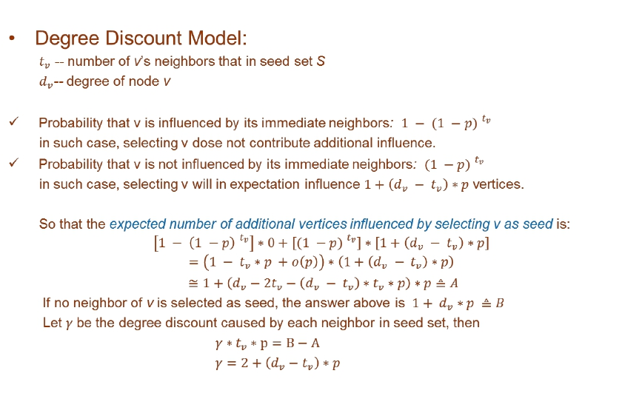
Degree Discount Heuristics

Slide 15
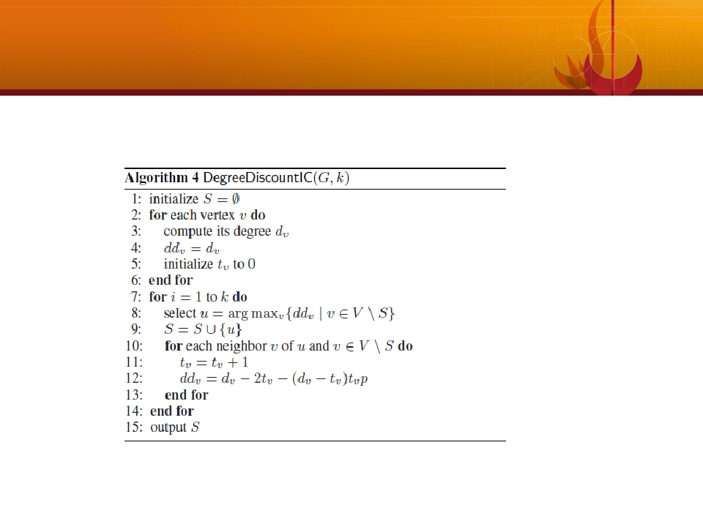
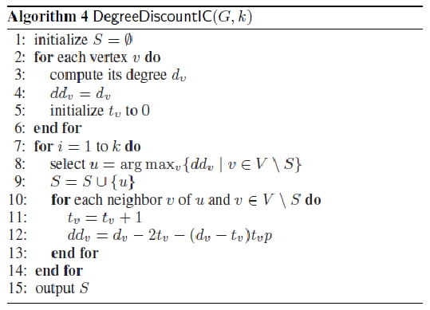
Degree Discount Heuristics
• Algorithm:

Slide 16
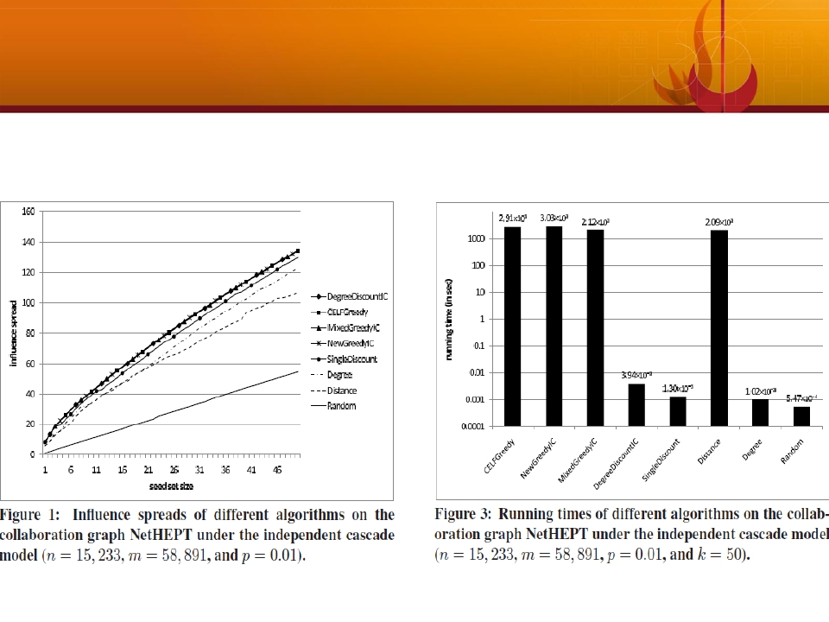
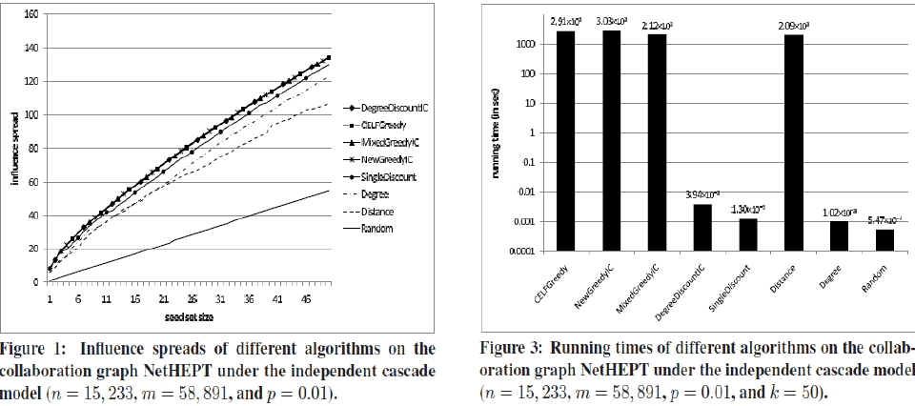
Degree Discount Heuristics
• Evaluations on NetHEPT:

Slide 17
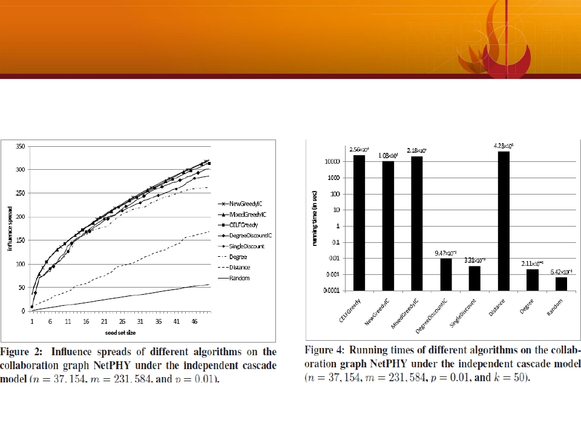
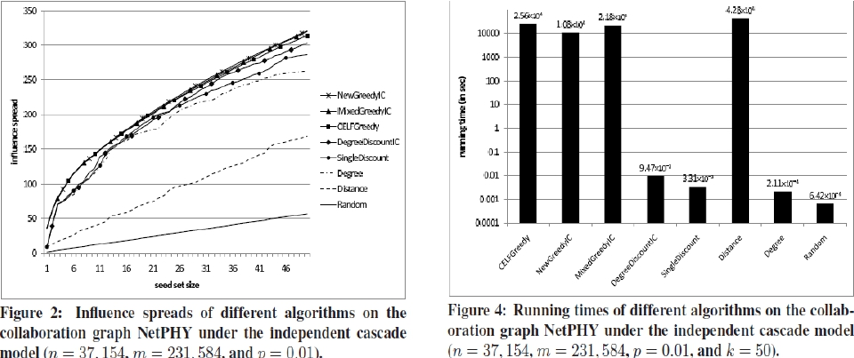
Degree Discount Heuristics
• Evaluations on NetPHY:

Slide 18
OUTLINE
• Problem
• Previous Work
• Degree Discount Heuristics
• Summary
• References

Slide 19
Summary
•
•
•
The current influence maximization problem is simplified, without
considering other features in social networks, such as community structures
and small-world phenomenon.
The author suggests that we should focus our research efforts on searching
for more effective heuristics for different influence cascade model in real life
influence maximization anpplications
More sophisticated heuristics are promising, such as taking into
consideration multiple links between nodes, higher-order influences, cross-
neighborhood structure…

Slide 20
OUTLINE
• Problem
• Previous Work
• Degree Discount Heuristics
• Summary
• References

Slide 21
References
•
•
W. Chen, Y. Wang and S. Yang ,“Efficient Influence Maximization in Social Networks”,
KDD 2009
D. Kempe, J. Kleinberg and E. Tardos, “Maximizing the Spread of Influence through a
Social Network”, KDD 2003

Slide 22
Thank you !

